Slide 1
hi

Slide 2


Project Presentation: Educational Investments
Hailey Bauer, Nolan Nguyen, Mike Powell, Noah Vanscoyoc, Alexandra Juarbe

Slide 3
Background & Objective
Traditional emphasis on higher education for success
Key Question: At what level do costs outweigh benefits regarding degree attainment?
Analysis based on 2021 National Survey of College Graduates and U.S. Bureau of Labor Statistics
Goal: Evaluate the benefits and costs of varying degree levels
Focus on evaluating benefits vs costs
Consideration of socioeconomic, financial, and demographic factors
Notes:
Traditionally there has always been a push for individuals to attain a college degree. We aim to answer the question "At what level do the costs outweigh the benefits regarding degree attainment?"

Slide 4


Scope
Focus on bachelor's, master's, and doctoral degrees
Professional degrees excluded to avoid data limitations
Population: US graduates under 76 years old (NSCG)
Notes:
Professional degrees are specialized degrees aka practical training, hands-on
The age limit of 76 in the study comes from the National Survey of College Graduates (NSCG) 2021 methodology and is significant for several reasons:
Labor Market Focus
The study primarily aims to understand active workforce participation and career outcomes
By age 76, most individuals have retired or left the active workforce
This cutoff helps focus on employment-related outcomes and career trajectories
Data Quality
More recent graduates provide better insights into current education costs and benefits
Salary and employment data becomes less relevant for retirement-age individuals
Helps avoid skewing data with outdated educational costs and career paths
Demographic Relevance
Captures multiple generations of graduates while maintaining current relevance
Includes both early-career and established professionals
Provides enough age range to analyze career progression and long-term benefits
Methodological Consistency
Aligns with other major educational and workforce studies
Provides a standardized comparison point across different surveys
Helps maintain statistical validity and reliability
Practical Considerations
Most educational investment decisions are made with working years in mind
Career benefits are most relevant during active working years
Retirement typically occurs before age 76

Slide 5


Data Needs
Primary Data Sources:
National Survey of College Graduates (NSCG)
U.S. Bureau of Labor Statistics
Sample Size: ~164,000 surveyed individuals
Geographic Scope: United States and Puerto Rico
Time Period: 2021 (some trends from 2003-2021)
Qualification: Bachelor's degree or higher
Notes:
All the specifications are related to the NSCG data with the Bureau of Labor Stats not having much info as to the population the data was gathered with. Both are from 2021.
Primary Data Sources:
The analysis is grounded in reliable data from the National Survey of College Graduates (NSCG) and the U.S. Bureau of Labor Statistics, ensuring comprehensive and credible insights.
Sample Size:
The survey covers 164,000 individuals, providing a large and diverse sample to support robust analysis.
Time Period:
Data primarily focuses on the year 2021, with some trends analyzed from 2003 to 2021, allowing us to understand both current outcomes and historical patterns.
Geographic Scope:
The study includes data from the United States and Puerto Rico, offering a broad geographical representation.
Qualification:
The analysis specifically targets individuals with a Bachelor's degree or higher, aligning with the study's focus on advanced education levels.
Key Point:
The dataset’s scale, scope, and reliability ensure that the findings are both accurate and applicable to a wide audience.

Slide 6

Methodology
Analysis Techniques:
Financial Metrics: Net Present Value (NPV), Benefit-Cost Ratio (BCR), Present Value (PV), and Return on Investment (ROI).
Population Data: Employment trends, NPV, BCR, ROI, PV, and demographic impacts.
Data Sources:
Tools:
National Survey of College Graduates (NSCG) and U.S. Bureau of Labor Statistics (2021).
Data organization, calculation, and visualization conducted in Excel.
Notes:
Key Focus:
To balance financial returns with population data insights, ensuring a comprehensive view of the costs and benefits of higher education.

Slide 7


Key Factors
Demographic Factors:
Financial Factors:
Sex, age, race, ethnicity, and nativity
Annual salary
Disability status
Amount borrowed
Socioeconomic Factors:
Labor force status
Job relevance
Certifications/licenses
Notes:
Socioeconomic Factors:
Labor force status, job relevance, and certifications/licenses are critical components for understanding employment outcomes.
Financial Factors:
The analysis includes annual salary and the amount borrowed to finance education, which impact the financial returns.
Demographic Factors:
These include sex, age, race, ethnicity, and nativity, as well as disability status, to ensure inclusivity in the evaluation of outcomes.
Key Point:
These factors collectively provide insights into how different groups benefit from or face challenges with higher education.

Slide 8
Benefits vs. Costs
Costs:
Unemployed
Benefits:
Not in the Labor Force
Employed
Unrelated Job-Degree Relation
Close Job-Degree Relation
Negative Relations Among:
Positive Relations Among:
Sex
Race/Ethnicity/Nativity
Disability Status
Degree
Sex
Race/Ethnicity/Nativity
Disability Status
Degree
Certifications/Licenses Obtained for Work Purposes
Certifications/Licenses Not Obtained for Work Purposes
Average Amount Borrowed to Finance a Degree
Median Annual Salary
Median Annual Salary (With Certification/License)
Median Annual Salary (Without Certifications/Licenses)
Average Cost of Degree (Annually)
Notes:
First, we look at employment - not just whether someone has a job, but their overall employability. Our data shows that higher degrees generally correlate with higher employment rates - from 74% for bachelor's to 81% for doctoral degrees.
Next, we consider job-degree alignment. This measures whether graduates work in their field of study. For example, while 44% of bachelor's degree holders work in jobs closely related to their studies, this jumps to 80% for doctoral degree holders.
We also analyze positive demographic trends, looking at how different groups fare in terms of:
Gender representation
Racial and ethnic outcomes
Accessibility for those with disabilities
Success rates across degree levels
In terms of financial benefits, we look at both base salaries and earnings potential. Our data shows median salaries ranging from $70,000 for bachelor's degrees to $100,000 for doctoral degrees.
Moving to the costs side:
We consider unemployment and workforce non-participation rates. This helps us understand the risks associated with each degree level.
We look at cases where degrees don't align with careers, which represents a potential waste of educational investment.
Financial costs include:
Direct borrowing costs, which average $12,449 for bachelor's degrees
Annual degree costs
Additional certification requirements
The impact of required credentials on salary

Slide 9


Benefits vs. Costs
Benefits:
Employed
Certifications/Licenses Not Obtained for Work Purposes
Close Job-Degree Relation
Median Annual Salary
Positive Relations Among:
Sex
Race/Ethnicity/Nativity
Disability Status
Degree
Median Annual Salary (Without Certifications/Licenses)
Notes:
First, we look at employment - not just whether someone has a job, but their overall employability. Our data shows that higher degrees generally correlate with higher employment rates - from 74% for bachelor's to 81% for doctoral degrees.
Next, we consider job-degree alignment. This measures whether graduates work in their field of study. For example, while 44% of bachelor's degree holders work in jobs closely related to their studies, this jumps to 80% for doctoral degree holders.
We also analyze positive demographic trends, looking at how different groups fare in terms of:
Gender representation
Racial and ethnic outcomes
Accessibility for those with disabilities
Success rates across degree levels
In terms of financial benefits, we look at both base salaries and earnings potential. Our data shows median salaries ranging from $70,000 for bachelor's degrees to $100,000 for doctoral degrees.

Slide 10


Benefits vs. Costs
Costs:
Unemployed
Certifications/Licenses Obtained for Work Purposes
Not in the Labor Force
Average Amount Borrowed to Finance a Degree
Unrelated Job-Degree Relation
Negative Relations Among:
Median Annual Salary (With Certification/License)
Sex
Race/Ethnicity/Nativity
Disability Status
Degree
Average Cost of Degree (Annually)
Notes:
We consider unemployment and workforce non-participation rates. This helps us understand the risks associated with each degree level.
We look at cases where degrees don't align with careers, which represents a potential waste of educational investment.
Financial costs include:
Direct borrowing costs, which average $12,449 for bachelor's degrees
Annual degree costs
Additional certification requirements
The impact of required credentials on salary

Slide 11
Population Data Observations
Bachelor's Degree:
Master's Degree:
74% employment rate
76% employment rate
44% close job alignment
66% close job alignment
Doctoral Degree:
81% employment rate
80% close job alignment
Notes:
This slide summarizes the population data observations regarding employment rates and job alignment for different levels of education.
Bachelor's Degree:
The employment rate is 74%, showing a strong job market participation for individuals with this degree.
Job alignment, or the proportion of jobs closely matching the degree, is 41%, suggesting moderate alignment between education and career.
Master's Degree:
The employment rate increases to 76%, indicating a slight improvement in job opportunities compared to a Bachelor's degree.
Close job alignment rises significantly to 66%, reflecting a stronger connection between the degree and relevant employment opportunities.
Doctoral Degree:
The employment rate reaches 81%, the highest among the three levels, showcasing the strong employability of individuals with advanced education.
Close job alignment is 80%, highlighting a substantial match between education and job requirements for Doctoral degree holders.
Key Takeaway:
As the level of education increases, both employment rates and the alignment between jobs and degrees improve. This demonstrates that advanced degrees not only provide better employment opportunities but also enhance the likelihood of securing jobs directly related to the field of study.

Slide 12
Data Analyses - Population
Bachelor's Degree:
Master's Degree:
BCR: 3.10
BCR: 2.93
ROI: 2.10
ROI: 1.93
NPV: $23.62
NPV: $13.29
Doctoral Degree:
BCR: 5.84
ROI: 4.84
NPV: $11.72
Context-dependent benefits
Notes:
This slide highlights the population-based data analyses for different degree levels, focusing on Benefit-Cost Ratio (BCR), Return on Investment (ROI), and Net Present Value (NPV).
Bachelor's Degree:
BCR: 3.10, indicating strong benefits relative to costs, with returns over three times the initial investment.
ROI: 2.10, demonstrating a significant return, more than doubling the cost of the degree.
NPV: $23.62, reflecting modest but positive net benefits for individuals with this degree.
Master's Degree:
BCR: 2.93, slightly lower than a Bachelor's degree but still indicates substantial benefits relative to costs.
ROI: 1.93, showing a return nearly double the investment.
NPV: $15.29, suggesting positive financial gains, though slightly reduced compared to a Bachelor's degree.
Doctoral Degree:
BCR: 5.84, the highest of all degrees, highlighting significant benefits in certain contexts.
ROI: 4.84, showcasing the potential for high financial returns depending on the situation.
NPV: $11.72, which is context-dependent and may vary widely based on individual circumstances.
Key Observations:
All values in this analysis are positive, indicating a positive relationship between benefits and costs for each degree level.
According to the population analyses, both Bachelor's and Doctoral degrees offer substantial benefits for individuals who obtain them.
However, attaining a Doctorate degree is highly context-dependent. The outcomes can vary significantly, with some individuals benefiting greatly while others may incur more costs than benefits.

Slide 13
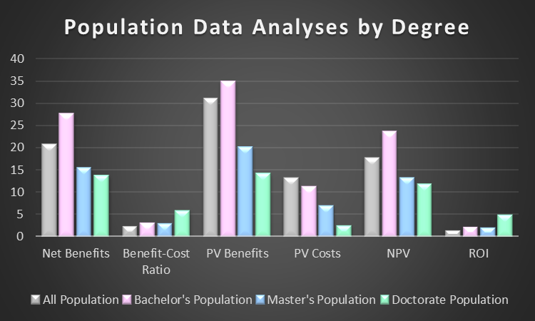
Population Data Analysis Visualizations
Notes:
Overview:
This bar chart compares key metrics of population data analysis across degree levels (Bachelor's, Master's, and Doctorate) as well as the overall population. The metrics include Net Benefits, Benefit-Cost Ratio (BCR), Present Value (PV) Benefits, PV Costs, Net Present Value (NPV), and Return on Investment (ROI).
Key Observations:
Net Benefits:
Bachelor's and Master's degrees show higher net benefits compared to Doctoral degrees, which highlights the diminishing financial returns of pursuing advanced education in certain cases.
The overall population trends align closely with Bachelor's degree outcomes, indicating its widespread value.
Benefit-Cost Ratio (BCR):
Doctorate degrees have the highest BCR, suggesting significant benefits in certain contexts. However, this must be weighed against the individual cost variations.
PV Benefits vs. PV Costs:
PV Benefits increase with higher education levels, but so do PV Costs, especially for Master's degrees. Doctorate degrees exhibit the highest benefits, but these benefits are context-dependent.
Net Present Value (NPV):
Bachelor's and Master's degrees maintain positive NPVs, whereas Doctoral degrees are highly variable, sometimes even negative depending on the circumstances.
ROI:
Bachelor's degrees have strong ROI values, followed by Master's degrees. Doctoral degrees show mixed ROI results, heavily influenced by external factors like field of study and funding availability.
Key Takeaway:
While Bachelor's and Master's degrees generally provide consistent benefits across all metrics, Doctoral degrees show the highest variability, making their outcomes highly context-dependent. These findings underscore the importance of considering both individual goals and financial constraints when pursuing higher education.

Slide 14
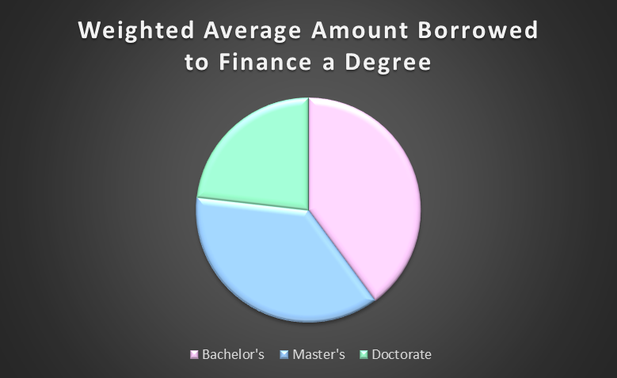
Financial Data Observation Visualizations
Bachelor's Degree:
Median salary: $70,000
Median borrowed: $12,448.92
Master's Degree:
Median salary: $84,000
Median borrowed: $11,530.19
Doctoral Degree:
Median salary: $100,000
Median borrowed: $7,233.49
Notes:
Overview:
This slide provides a comparison of median salaries and median amounts borrowed for Bachelor's, Master's, and Doctoral degrees.
It includes a pie chart illustrating the weighted average amount borrowed to finance each degree level.
Bachelor's Degree:
Median salary: $70,000
Median amount borrowed: $12,448.92
This reflects relatively lower borrowing compared to advanced degrees, with moderate returns in median salary.
Master's Degree:
Median salary: $84,000
Median amount borrowed: $11,530.19
Slightly higher salaries are observed compared to Bachelor's degrees, with a modest decrease in borrowing, likely due to scholarships, grants, or savings.
Doctoral Degree:
Median salary: $100,000
Median amount borrowed: $7,253.49
Higher earnings are associated with Doctoral degrees, while the borrowing amount decreases significantly, likely due to employer-sponsored programs or stipends during graduate studies.
Pie Chart Insight:
The weighted average amount borrowed shows how borrowing is distributed across degree levels, emphasizing the relative affordability of Doctoral programs due to external funding opportunities.
Key Takeaway:
While salaries increase with higher education levels, the amount borrowed decreases proportionally for advanced degrees, likely due to additional funding opportunities and employer support.

Slide 15
Data Analyses - Financial
Bachelor's Degree:
BCR: 1.27
ROI: 0.27
NPV: $25,501.45
Master's Degree:
BCR: 1.19
ROI: 0.19
NPV: $23,616.37
Doctoral Degree:
BCR: 0.84
ROI: -0.16
NPV: -$31,393.10
Notes:
This slide presents a financial analysis of the three educational degree levels: Bachelor's, Master's, and Doctoral.
Bachelor's Degree:
The Benefit-Cost Ratio (BCR) is 1.27, indicating that for every dollar invested, there is a return of $1.27.
The Return on Investment (ROI) is 0.27, showing a 27% return relative to the costs.
The Net Present Value (NPV) is positive at $25,501.45, meaning the degree provides a financial gain over time.
Master's Degree:
The BCR decreases to 1.19, which is still positive but reflects diminishing returns compared to a Bachelor's degree.
ROI drops to 0.19, or 19%, showing reduced financial efficiency.
The NPV remains positive at $25,616.37, slightly lower than the Bachelor's degree, indicating continued but reduced financial viability.
Doctoral Degree:
The BCR falls below 1, at 0.84, indicating the costs of obtaining this degree outweigh the benefits.
The ROI is negative at -0.16, or -16%, reflecting a loss in financial returns.
The NPV is negative, at -$31,393.10, demonstrating a financial loss over time.
Key Takeaway:
As the level of education increases, the financial returns diminish due to higher costs, as evidenced by the declining BCR, ROI, and NPV values. While Bachelor's and Master's degrees provide financial benefits, a Doctoral degree presents a financial loss in this analysis.

Slide 16
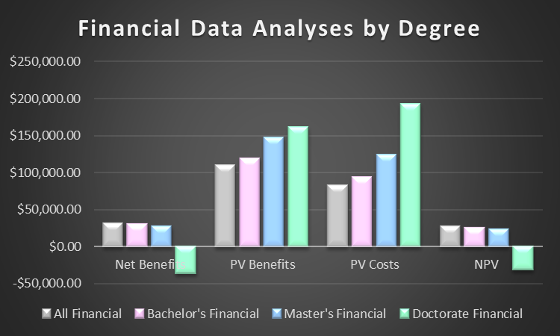
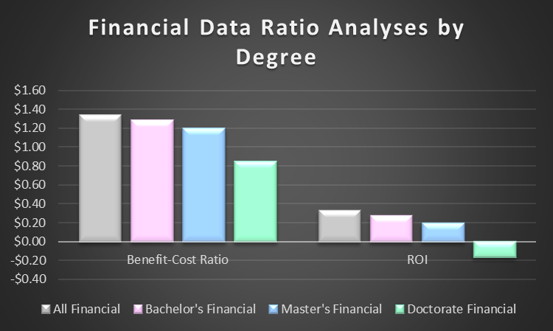


Financial Data Analysis Visualizations
Notes:
Overview:
This slide features two visualizations comparing financial metrics across Bachelor's, Master's, and Doctoral degrees, as well as the overall financial population.
Left Chart: Financial Data Analyses by Degree
Net Benefits:
Bachelor's and Master's degrees show positive net benefits, reflecting financial gains for individuals.
Doctoral degrees exhibit highly variable net benefits, with some individuals incurring financial losses due to high costs and context-dependent returns.
PV Benefits and PV Costs:
Present Value (PV) benefits increase significantly with higher degrees, with Doctorate degrees offering the highest benefits in certain scenarios.
However, PV costs also rise steeply for Doctorate degrees, underscoring the financial burden of advanced education.
Net Present Value (NPV):
Bachelor's and Master's degrees maintain consistently positive NPVs, while Doctoral degrees show lower or even negative NPVs, depending on individual circumstances.
Right Chart: Financial Data Ratio Analyses by Degree
Benefit-Cost Ratio (BCR):
All degrees have a BCR greater than 1, indicating positive returns on investment.
Bachelor's degrees have the highest BCR, followed by Master's degrees, suggesting they offer the best balance between costs and benefits.
Return on Investment (ROI):
ROI is highest for Bachelor's degrees, followed by Master's degrees, emphasizing the financial viability of these education levels.
Doctoral degrees show significantly lower ROI, highlighting the need for careful consideration of career outcomes and funding availability.
Key Takeaway:
Bachelor's and Master's degrees consistently provide strong financial returns with manageable costs, making them attractive options for most individuals.
Doctoral degrees, while offering potential for high benefits, are highly context-dependent and often come with greater financial risks.

Slide 17


Executive summary: Bachelor's Degree
Employment Rate: 74%
Job-Degree Alignment: 44% close relation
Median Annual Salary: $70,000
Median Borrowing: $12,448.92
BCR: 3.10
Bachelor's Degree: Most economically advantageous (BCR: 3.10, ROI: 2.10)
Strong ROI: Most economically advantageous choice
Notes:
This slide showcases the most prominent observations within the benefit-cost analysis of pursuing a Bachelor's degree.
Key observations include:
Population Data:
Employment Rate (the probability that an individual with a bachelor's degree is employed): 74%
Job-Degree Alignment (the probability that an individual with a bachelor's degree has a close job-degree relation): 44%
Financial Data:
Median Annual Salary (given the individual had a bachelor's degree): $70,000
Median amount borrowed to finance a bachelor's degree: $12,448.92
Key analysis observations include:
Benefit-Cost Ratio (benefits/costs): 3.10
Return on Investment: 2.10
These strong ROI and BCR values demonstrate why obtaining a bachelor's degree is the most economically advantageous. Therefore, it would be a good choice to obtain this degree.

Slide 18

Executive summary: Master's Degree
Employment Rate: 76%
Job-Degree Alignment: 66% close relation
Median Annual Salary: $84,000
Median Borrowing: $11,530.19
BCR: 2.93
Master's Degree: Positive but narrower returns (BCR: 2.93, ROI: 1.93)
Positive but narrower returns than Bachelor’s
Notes:
This slide showcases the most prominent observations within the benefit-cost analysis of pursuing a Master's degree.
Key observations include:
Population Data:
Employment Rate (the probability that an individual with a master's degree is employed): 76%
Job-Degree Alignment (the probability that an individual with a master's degree has a close job-degree relation): 66%
Financial Data:
Median Annual Salary (given the individual had a master's degree): $84,000
Median amount borrowed to finance a master's degree: $11,530.19
Key analysis observations include:
Benefit-Cost Ratio (benefits/costs): 2.93
Return on Investment: 1.93
While the BCR and ROI indicate a positive and strong value for this analysis, it is less than those for the bachelor's degree. Therefore, it is an economically advantageous choice but not as beneficial as a bachelor's degree.

Slide 19


Executive Summary: Doctoral Degree
Employment Rate: 81%
Job-Degree Alignment: 80% close relation
Median Annual Salary: $100,000
Median Borrowing: $7,233.49
BCR: 5.84
Highest potential returns but context-dependent
Notes:
This slide showcases the most prominent observations within the benefit-cost analysis of pursuing a Doctorate degree.
Key observations include:
Population Data:
Employment Rate (the probability that an individual with a doctorate degree is employed): 81%
Job-Degree Alignment (the probability that an individual with a doctorate degree has a close job-degree relation): 80%
Financial Data:
Median Annual Salary (given the individual had a doctorate degree): $100,000
Median amount borrowed to finance a doctorate degree: $7,233.49
Key analysis observations include:
Benefit-Cost Ratio (benefits/costs): 5.84
Return on Investment: 4.84
While the analysis values indicate a strong relationship for the attainment of a doctorate degree, this varies greatly between financial and population values. Therefore, this degree has the highest potential returns but is very context-dependent, meaning that for some degrees or careers it may be more beneficial to obtain a doctorate degree than others. This relationship is one that may be explored in future studies.

Slide 20


Executive summary Final
Higher degrees correlate with better employment rates and job alignment
Financial returns diminish with each additional degree level
Individual circumstances significantly impact educational investment value
Non-monetary benefits must be considered in advanced degree decisions
Notes:
Overall, the following observations and conclusions have been found through our analyses:
As the level of the degree increases there is a proportional increase in employment rates and in the job-degree relation.
As the level of the degree increases, the financial returns (net benefits) are reduced. This is logical, as higher-level degrees involve greater costs compared to lower-level degrees, leading to a decrease in overall financial returns.
The individual circumstances (occupation, gender, race, age, etc.) significantly influences the educational investment value which determines when the attainment of a degree is viable.
Especially in higher degrees, non-monetary benefits must be considered to provide a comprehensive analysis of the overall impact of the attainment of the degree.

Slide 21


Sensitivity Analysis
Population Data Variations:
Employment probability: ±10% (75.46% baseline)
Job relevance: ±15% (54.14% baseline)
Financial Data Sensitivity:
Demographic factors impact
Salary variations: ±10%
Borrowing amount impact
Discount rate effects
Notes:
Overview:
This slide presents a sensitivity analysis examining how variations in key population and financial factors impact the outcomes of the analysis.
Population Data Variations:
Employment Probability:
A variation of ±10% around the baseline of 75.46% is analyzed to understand how changes in employment rates affect outcomes.
Job Relevance:
A variation of ±15% around the baseline of 54.14% explores how shifts in the alignment between education and job roles influence the results.
Demographic Factors Impact:
The sensitivity to demographic characteristics, such as age, sex, ethnicity, and disability status, is assessed to ensure a comprehensive understanding of population-specific effects.
Financial Data Sensitivity:
Salary Variations:
Analyzed at a ±10% range to assess how fluctuations in median salaries influence the financial returns of each degree level.
Borrowing Amount Impact:
Changes in the amount borrowed for education are considered to evaluate their effect on financial metrics like NPV and ROI.
Discount Rate Effects:
Variations in the discount rate are examined to understand their influence on the present value calculations of benefits and costs.
Key Takeaway:
This sensitivity analysis highlights how small variations in critical factors can significantly impact the overall results. It underscores the importance of considering a range of scenarios when evaluating the costs and benefits of higher education.

Slide 22

Conclusions
Bachelor's degree: Most economically advantageous for majority
Master's degree: Positive investment with strategic planning
Doctoral degree: Polarizing option - high returns in specific contexts
Decision depends heavily on individual circumstances
FINANCIAL / NON-MONETARY BENEFITS
KEY CONSIDERATIONS:
Bachelor's degree: Most economically advantageous
Individual circumstances
Career goals
Master's degree: Positive but requires strategic planning
Financial capacity
Doctoral degree: Context-dependent value
Non-monetary benefits
Notes:
Key Points:
Bachelor's Degree:
Most economically advantageous for the majority due to consistent financial returns and manageable costs.
Master's Degree:
A positive investment but requires strategic planning to maximize benefits, such as selecting high-demand fields.
Doctoral Degree:
A polarizing option that offers high returns in specific contexts but is highly dependent on individual circumstances and career paths.
Individual Circumstances:
The decision to pursue higher education depends on factors such as career goals, financial capacity, and non-monetary benefits like personal growth and societal contributions.
Key Considerations:
Financial and non-monetary benefits should both be evaluated.
For most, a Bachelor's degree is the most practical option, while Master's and Doctoral degrees require careful consideration of long-term value.

Slide 23

Recommendations for Future Research
Demographic segmentation analysis
Longitudinal studies on long-term outcomes
Regional and international comparisons
Social returns and intergenerational benefits
Impact of technological advancement
Remote learning effects
Alternative education pathways
Economic resilience
Notes:
Suggestions for Further Study:
Demographic Segmentation Analysis:
Investigate how different demographics benefit from higher education.
Regional and International Comparisons:
Compare the value of education in different regions or countries.
Impact of Technological Advancement:
Examine how emerging technologies affect the relevance and returns of various degrees.
Alternative Education Pathways:
Explore non-traditional routes like certifications, vocational training, and online education.
Longitudinal Studies:
Assess long-term outcomes of degree attainment on career and personal development.
Social Returns and Intergenerational Benefits:
Study the broader societal impacts of higher education, including benefits for families.
Remote Learning Effects:
Evaluate the influence of remote education on the costs and returns of higher education.
Economic Resilience:
Investigate how higher education supports individuals during economic downturns.
Key Takeaway:
Future research should broaden the scope of analysis to include societal impacts, alternative pathways, and global perspectives to ensure higher education remains relevant and accessible.

Slide 24
Works Cited
“2021 Annual Averages ‐ Household Data ‐ Tables from Employment and Earnings.” U.S. Bureau of Labor Statistics, U.S. Bureau of Labor Statistics, 19 Jan. 2023, www.bls.gov/cps/cps_aa2021.htm#certs_licenses.
Hanson, Melanie. “Average Cost of a Doctorate Degree [2023]: Ph.d., Psy.D. & More.” Education Data Initiative, 22 Feb. 2024, educationdata.org/average-cost-of-a-doctorate-degree. Accessed 23 Oct. 2024.
Hanson, Melanie. “Average Cost of a Master’s Degree: 2024 Analysis.” Education Data Initiative, 27 Feb. 2024, educationdata.org/average-cost-of-a-masters-degree. Accessed 23 Oct. 2024.
Hanson, Melanie. “Average Cost of College [2024]: Yearly Tuition + Expenses.” Education Data Initiative, 28 May 2024, educationdata.org/average-cost-of-college. Accessed 23 Oct. 2024.
“National Survey of College Graduates (NSCG)2021.” NSF, ncses.nsf.gov/surveys/national-survey-college-graduates/2021#methodology. Accessed 29 Aug. 2024.

